Slide 1
Web Applications using Php & SQL

Slide 2
Objectives
Chapter 7
Php language overview
HTML forms
HTML form input
The completed form invokes a program on the server
The program reads/updates database
Walkthrough the JRJ sample application

Slide 3
setup
Download jrj.zip
and unzip into the apache2/htdocs directory
You should now have a folder apache2/htdocs/jrj that contains the files.
Modify the 4 php files, change the $Password variable to your root password
InsertNewCustomer.php
ReadItem.php
ReadPurchase.php
ReadPurchaseItemItemView.php
Open the script JRJ create tables.sql in MySql Workbench and execute it to create the JRJ database tables
You should be able to enter the url at a browser
http://localhost/jrj
All the links should work successfully

Slide 4
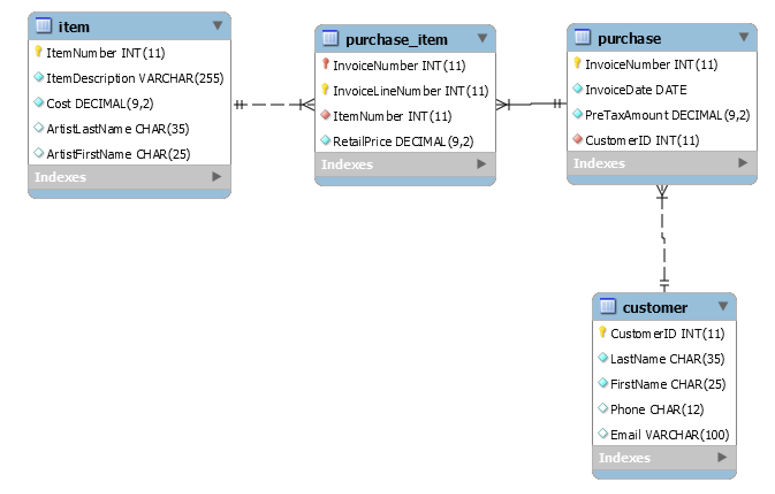
James River Jewelry (JRJ)
JRJ Store has jewelry items for sale
Each item has unique itemNumber
Customers make purchases
Each purchase is identified by an Invoice Number
A purchase may be for one or more items
Sales price is different from item cost

Slide 5
Php
A scripting language that can be embedded into html
Php “echo” statement is like print statement in C or Java
The output of echo will be inserted into the html document replacing the php script statements
<html>
<head>
<title>Online PHP Script Execution</title>
</head>
<body>
<?php
echo "<h1>Hello World, PHP!</h1>";
?>
</body>
</html>

Slide 6
Php
After execution the html becomes
<html>
<head>
<title>Online PHP Script Execution</title>
</head>
<body>
<h1>Hello World, PHP!</h1>
</body>
</html>

Slide 7
Php Variables
Php variables begin with $ character
Php statements are terminated by semi-colon character
Names are case sensitive $d is not same as $D
date(“D”) is a php function that returns day of week
<html>
<body>
<?php
$d = date("D");
if ($d == "Sun") {
echo "Have a nice Sunday!";
} else {
echo "Have a nice day.";
}
?>
</body>
</html>
Notes:
As in other languages, = is assignment operator, == is comparison operator. You can use print keyword instead of echo.

Slide 8
Php Comments
// # and /* */ are used for comments
<html>
<body>
<?php
$d = date("D"); // a one line comment
if ($d == "Sun") {
echo "Have a nice Sunday!";
} else {
/* a multi line
comment */
echo "Have a nice day."; # a one line comment
}
?>
</body>
</html>

Slide 9
Php Strings
Strings can be enclosed in single or double quotes
Variables that appear in double quoted will be expanded.
<html>
<body>
<?php
$d = date("D");
if ($d == "Sun") {
echo "Have a nice Sunday!";
} else {
echo "Have a nice $d!";
}
?>
</body>
</html>

Slide 10
Php loops
Values can be string, number, boolean or other
Arithmetic, string, and logic operations and functions
The dot is string concatenation.
<html>
<body>
<?php
$a = 1;
$b = 2;
$msg = 'At the end of the loop ';
for( $i = 0; $i<5; $i++ ) {
$a += 10;
$b += 5;
}
echo $msg . "a = $a and b = $b";
?>
</body>
</html>
Notes:
See php manual for list of all php data types. Including: resources, array, object, NULL
While and do-while loops are supported.

Slide 11
Php arrays
Array index can be integer or string
<html>
<body>
<?php
// create empty array
$array = array();
$array["foo"] = "bar";
$array["bar"] = "foo";
echo $array["bar"] . "<br/>";
// enumerated array with keys 0, 1, 2, 3
$array2 = array ("foo", "bar", "hello", "world");
echo $array2[2] . "<br/>";
?>
</body>
</html>
Notes:
Mysqli methods fetch_row, fetch_assoc, fetch_array return one row of a result set as an enumerated array, associative array or both.

Slide 12
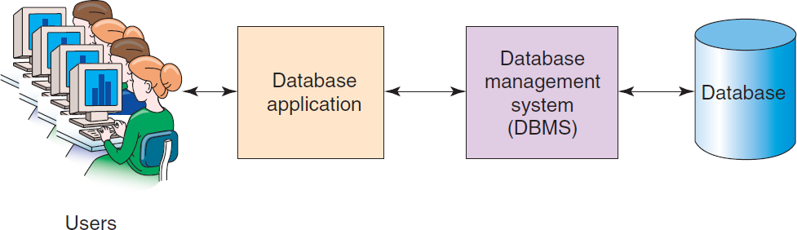
The Web Application Processing Environment
Complications due to
Communication over internet
Mobile devices
Multiple users
Multiple applications and databases
Databases, files and email
Security

Slide 13
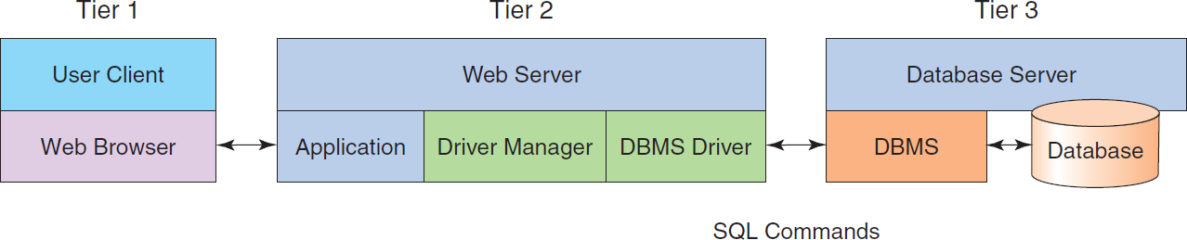
ODBC: Three-tier Web Server Architecture
App php scripts execute here
Tiers 2 & 3 can be on different or same computer(s)
(Windows only) there is a common api: ODBC
(Java only) there is a common api: JDBC
For Linux, non-Java, use DBMS specific apis
If you change DMBS, you will have to change the code.
In this class, Tier 2 is apache web server, Tier 3 is MySQL
We will use the mysqli apis instead of ODBC.
Notes:
Api: application programming interface. The set of functions that the application uses to communicate with DBMS.

Slide 14

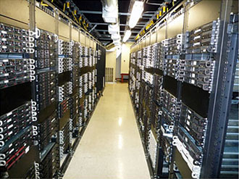
The Big picture – html file
HTTP request header + body
request type GET, url, cookie (optional), parameters (optional)
http://www.un.org/en/sections/what-we-do/index.html
HTTP response header + body
Return code, cookie (optional), content (html document)
Http request message contains the URL of a file at the server.
Server retrieves and sends the file to browser in Http response body. A return code of 200 indicates success.

Slide 15
The Big picture – html forms
HTTP request header: GET request type, url
http://voyager.csumb.edu/vwebv/searchAdvanced
HTTP response header + body: html
User fills out form fields and presses SUBMIT button
HTTP request header: GET/POST, url, name,value data pairs
HTTP response header + body html
URL requests download of an html document containing form
User fills in form fields and presses SUBMIT
The form tag contains
action= the name of the server program to process the data,
method= whether a GET or POST type request is done.
GET type request puts the name, value parameters into the URL
POST type request puts the name, value parameters into the request body.
The server program processes the data and sends acknowledgement or error message to client.

Slide 16
HTML form with POST file: NewCustomerForm.html
<!DOCTYPE html>
<html>
<body>
<form action="InsertNewCustomer.php" method="POST">
<p><b>Enter Customer Name, Phone Number and Email:</b></p>
<table>
<tr>
<td>Last Name:</td>
<td><input type="text" name="LastName" size="25" /></td>
</tr>
<tr>
<td>First Name:</td>
<td><input type="text" name="FirstName" size="25" /></td>
</tr>
<tr>
<td>Phone Number:</td>
<td><input type="text" name="Phone" size="12" /></td>
</tr>
Notes:
Update, delete sql statements are similar.

Slide 17
HTML form with POST
<tr>
<td>Email Address:</td>
<td><input type="text" name="Email" size="50" /></td>
</tr>
</table>
<p>
<input type="submit" value="Add New Customer" />
<input type="reset" value="Reset Values" />
</p>
</form>
</body>
</html>
Notes:
Update, delete sql statements are similar.

Slide 18
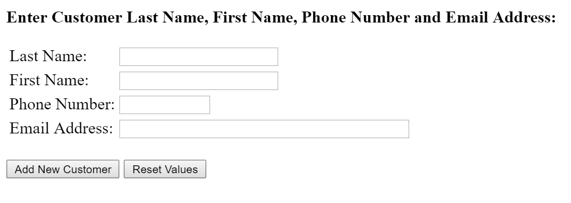
HTML form with POST
Notes:
Update, delete sql statements are similar.

Slide 19
Server program
Connect
Get parameters
SQL
Display result
Disconnect
Perform error checking at each step
Result will depend on type of SQL statement: SELECT, INSERT, UPDATE, or DELETE

Slide 20
Connect to database
Parameters : HostName, User, Password, Database,
tcpip port number of DBMS (optional)
Terminate if connection fails.
<html>
<head>
<title>Php sql example </title>
</head>
<body>
<?php
// make a connection
$conn = new mysqli("localhost", "root", "dw4Math" ,
“cs51c", 3306);
if ($conn->connect_errno) {
exit ("Failed to connect: (" . $conn->connect_errno .
") " . $conn->connect_error );
}
Notes:
Mysqli methods fetch_row, fetch_assoc, fetch_array return one row of a result set as an enumerated array, associative array or both.

Slide 21
Perform insert statement
Get data from POST request and create SQL insert
Insert null value to column CustomerID which is auto generated.
$LastName = $_POST["LastName"];
$FirstName = $_POST["FirstName"];
$Phone = $_POST["Phone"];
$Email = $_POST["Email"];
// Create SQL statement to INSERT new data
$SQLINSERT = "INSERT INTO CUSTOMER ";
$SQLINSERT .= "VALUES( null, '$LastName', '$FirstName', ";
$SQLINSERT .= "'$Phone', '$Email')";
// Execute SQL statement and check result
$res = $conn->query($SQLINSERT);
if ($conn->affected_rows == 1 ){
echo "<h2>New Customer Added: “. $conn->insert_id .”</h2>”;
} else {
exit “Insert Failed.”;
}
Notes:
Update, delete sql statements are similar. Insert_id is auto-generated key value for column CustomerID.

Slide 22
Perform select statement
Retrieve all rows and columns from Customer table
// Create SQL statement to read CUSTOMER table data
$SQL = "SELECT * FROM CUSTOMER";
// Execute SQL statement
$res = $conn->query($SQL);
// Test existence of recordset
if (!$res) {
exit ("Select failed: (" . $conn->errno . ") " .
$conn->error);
}
Notes:
Mysqli methods fetch_row, fetch_assoc, fetch_array return one row of a result set as an enumerated array, associative array or both.

Slide 23
Process select result
Create html table header
// Table header
echo "<table class='output' border='1'>
<tr>
<th>LastName</th>
<th>FirstName</th>
<th>Phone</th>
<th>Email</th>
</tr>";
Notes:
Mysqli methods fetch_row, fetch_assoc, fetch_array return one row of a result set as an enumerated array, associative array or both.

Slide 24
Process select result
Loop for each row of result table
Fetch_assoc() returns associative array of column values keyed by column name (case sensitive)
// Table data
while($RecordSetRow = $res->fetch_assoc() ) {
echo "<tr>";
echo "<td>" . $RecordSetRow['LastName'] . "</td>";
echo "<td>" . $RecordSetRow['FirstName'] . "</td>";
echo "<td>" . $RecordSetRow['Phone'] . "</td>";
echo "<td>" . $RecordSetRow['Email'] . "</td>";
}
echo "</table>";
Notes:
Could also use fetch_row() to retrieve row data as enumerated array.

Slide 25
Disconnect
// close connection
$conn->close();
?>
</body>
</html>
Notes:
Mysqli methods fetch_row, fetch_assoc, fetch_array return one row of a result set as an enumerated array, associative array or both.

Slide 26
Debugging
Errors are written to the apache error.log file in the apache2/logs directory.
Use notepad++ (textwrangler on Mac OsX) to view.
Misspelling variables name (names are case sensitive), forgetting semicolon are common mistakes.
Add temporary echo statements to the script to display variables and trace flow of execution.
Check return values from sql functions.
[pid 3480:tid 1192] [client ::1:57248] PHP Parse error: syntax error, unexpected '}', expecting ',' or ';' in C:\\Bitnami\\wampstack-5.6.22-0\\apache2\\htdocs\\lab2\\examplesql.php on line 49
example error log entry

